Slide 1
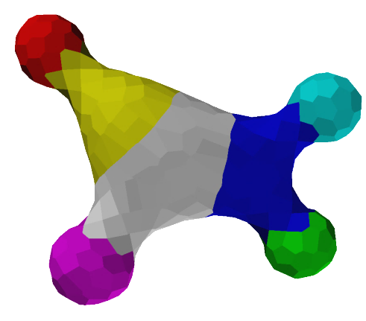
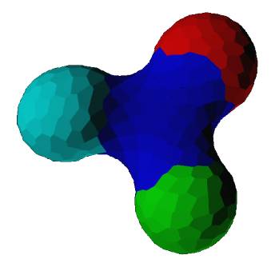
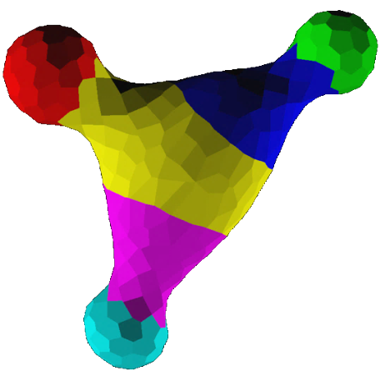
Measure Twice, Cut Twice: Reliable Development through Overlapping Mechanisms
Micah Brodsky
ECAL 2015
Notes:
I’m me / TY Rene/Hiroki
In this talk,
Walk thru a model of morphogenesis been working on
In particular, present several exs of curious phenom:
V. better results not from universal mechs or careful, exact sols.
But, multiple overlapping simple mechs, none complete
I.e. better to do poorly multiple ways than well one way
Better = easier to develop, faster, more robust
As general strategy,
Call this approach “partial redundancy” – multiple incomplete mechs, each partly but not fully redundant with the others
Seems to be important strategy for reliable homeostasis

Slide 2
Morphogenesis as homeostasis
[Image of regenerating planarians;
Removed for copyright reasons]
Notes:
Morpho, I maintain, best thought as homeostasis prob:
Stability of dev (“canalization”) – tendency to recover from perturb
Suggests homeostasis
Regeneration, then, is other side of the coin
Ex: Radical regen e.g. planarian (cut up as shown)
Makes sense to suppose the same program is re-used, rather than a separate regen pat process
Dev program returns system to envelope of acceptable structures
Even higher organisms:
Wound healing (i.e. fetus!)
(Limitations like scarring reflect special mechs for rapid recovery, for prev. blood loss & infection control?)
[Adult shape changes accommodating e.g. exercise]
So, what does it mean to recognize morpho & regen as homeo

Slide 3
Controllers & redundancy
What does homeostasis mean?
Feedback!
Morphology: Difficult example
Sensor-actuator loops
Goal specification
Actuator
Spatial structures
Sensor
Notes:
Homeostasis means feedback!
Dynamics sensitive to state of system
Simple cases: inanimate dynamics like ball or droplet
More complex (morpho very complex), might expect to see discrete control loops w/separate sensors & actuators
If we follow this, task is to identify appropriate sensing & actuation mechs & devise control algorithms
(As alluded.. One loop or many? One of each actuator & sensor or many? Q we’ll look at.)
But first, simplify prob by factoring.

Slide 4
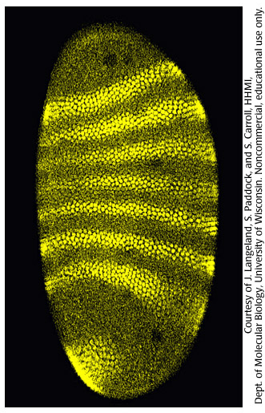
Body plans
Why?
Design (or evolve) layout separate from details
Re-usable parts
Passive “coloring book” doesn’t work
Need closed-loop patterning algorithm
Notes:
Simplify dev control prob w/ page from nature:
Split morphogenesis into “body plan pattern” for layout
& morphogenetic processes that produce features according to plan
Why?
Modularity – repeatedly parts like body segments, and ability to manipulate layout apart from component details.
But, if want regen, or even if we want to deal with disruptive morpho processes, can’t just paint pat & be done. (cbook)
Pat needs to self-repair – closed loop algo, body plan homeostasis.

Slide 5
Normal neighbors patterning
Discrete abstraction: Regions
Local topology: What contacts what
Soft constraint propagation
Nearest-neighbor communication
Cousins: Ising & Potts models, loopy belief propagation
1
2
1
2
5
5
4
3
4
3
Notes:
Here’s a homoestatic pat algo I dev’ed based on idea from devbio: RNN
Cells ‘n tissues know what types of tissues to expect as neighbors; if wrong, correct
For patterning, absract as adj graph: Parts and arrangement.
Topolog. description.
Enforce by constraint prop
Resulting algo akin to Ising & Potts, LBP
Not only possible body plan algo, but satisfies key desiderata:
Self-correcting
Deformation-tolerant (topological)
Let’s have a look at how behaves.

Slide 6
Pattern convergence
Symmetry breaking ⇒ Slow
Speed it up? Avoid local minima?
Add another algorithm!
(What about those naïve coloring books?)
Vids here plz
Normal neighbors alone
With pre-initializer
Notes:
LL: same pat as prev example, basic RNN constraint prop ¶
Works well, but limitations: slow, sometimes ∃ local minima
A 90% solution.
What to do? Add another partial solution!
LR: cells polarized. ¶
Simple autonomous algo – open-loop coloring book – paints partial pat. (poorly!) ¶
Watch: ~4x faster, highly resistant to local minima
1st example: two not quite adequate algos (latter esp. sketchy) ➔ 1 super algo
Familiar w/drosophila seg cascade…? seem familiar?
Important clue for what it’s trying to do.

Slide 7
Controlling shape
Background: Substrate model
Sensing
Actuation
Composition
Notes:
Now we have body plan mech, rest of talk on controlling shape according to plan – generating morphology
Simple case: controlled spherical curvature
Briefly, substrate model
How to sense, actuate
Once we’ve done that, we’ll worry about how to put body pieces together according to body plan
(essential role of smoothing, relaxation)

Slide 8
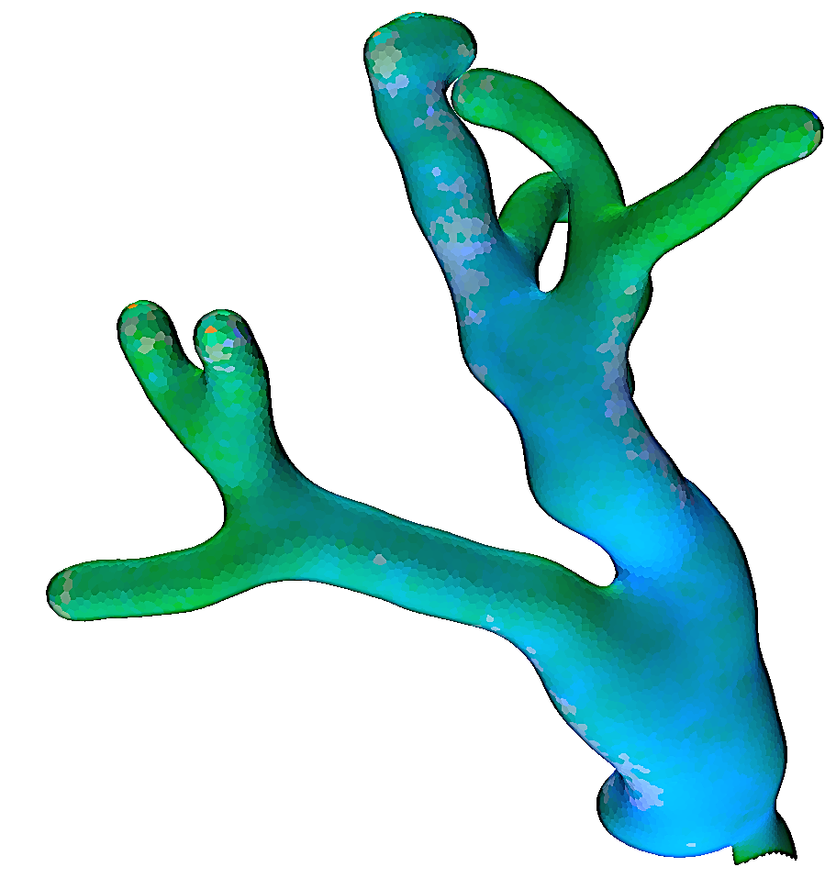
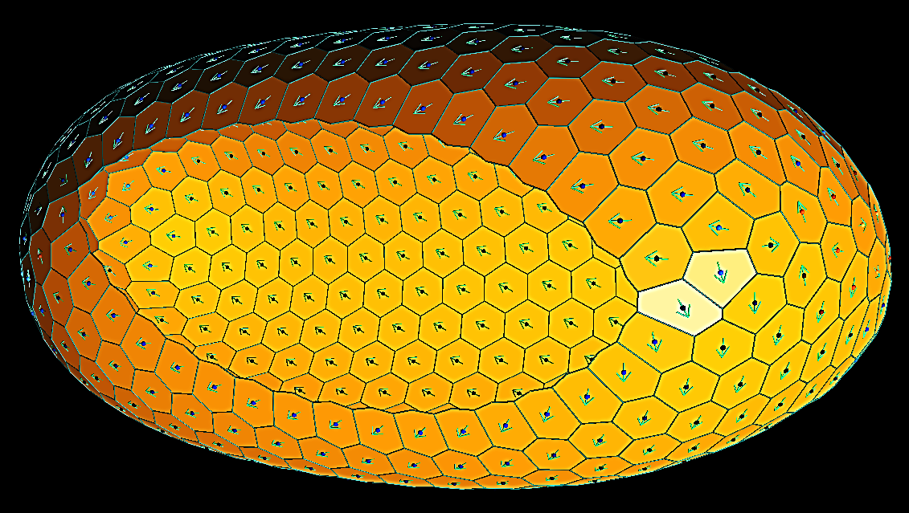
Model background: Low-Fi “2½-D”
Surfaces instead of volumes
“Vertex model”
Cell parameters: nat. area, elasticity, surface tension, flexural stiffness
Notes:
To pattern morphology, need phys substrate!
Here’s a substrate model I dev’ed for my thesis.
Key insight (if you’re familiar with embryology): Tremendous span of developmental processes (including the major early steps of embryogenesis) are surface-centric.
Model epithelial morphogenesis
Capture just surface mechanics, and leave volume implicit.
Vertex model:
Break tissue surface into discrete tessellation of independent cells. Modeled on mech. of 2D foam. (Ext’d to 3d)
(Assume cells know how to maintain confluent surface and just provide per-cell mechanical control parameters.)
Cell params: Natural area, surface tension, junction bend angles
Take closer look at tissue deformation

Slide 9
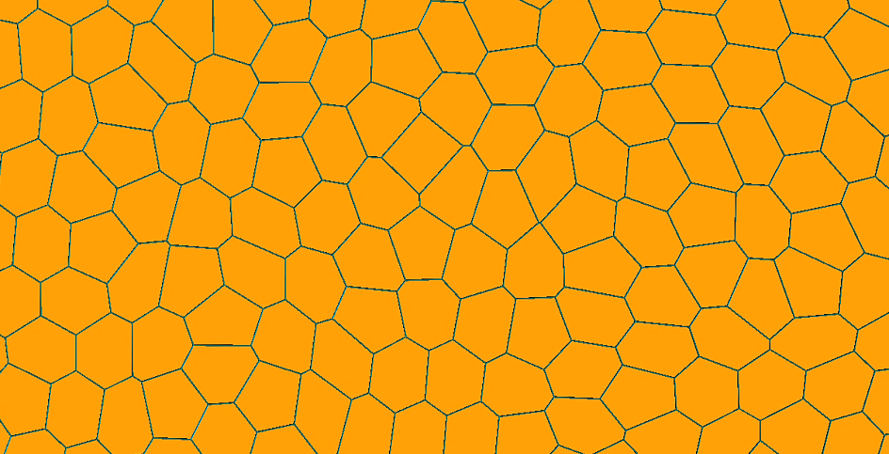
Model background: Plastic flow
Irregular mesh
Cells can migrate and flow
“T1” process
Notes:
How to model deformability of dev. tissue, ability to flow?
Look at how epi cells organized:
3-fold junctions like soap bubbles.
Slide plastically (T1)
Active tractions (drive interchanges, among other things)
Micro-scale process
Repeated over lots of cells, macro-scale effects
Example: convergent extension
Cells can migrate & flow to produce non-flat intrinsic geometries
Now we have a reasonable substrate model
How to form 3d structures with it?

Slide 10
Sensing curvature
Area / perimeter
Cell curvature
(1/R)
Notes:
Let’s start with the sensors. How might cells measure curvature? (sph)
‘couplea possibilities.
Entire region
A/P: compare two caps
Global measure (like SA/V ratio)
Sense with morphogens
Cell curvature: local measure
Sense with cytoskeleton, ratio of apical to basal area (or lateral spaces?)
(math: extrinsic)
Both reasonable measures, somewhat different. But, both limited range of applicability cuz scale-dependent.
(Units involve length dims.) Specify desired curvature, only means particular shape at a particular scale.
OTOH, multiply together, scale effects cancel.
Scale invariant measure of shape, related to subtended angle.
2nd example: by combining redundant measures of curvature, got new measure with much broader applicability
(and both local & global sensitivity)

Slide 11
Actuating curvature
Curvature actuation
Traction-driven intercalation
E.g. purse-string
Apico-basal constriction
Notes:
Now we know how to measure curvature. How do we manipulate it?
Couple of choices, but the most useful strategies are traction flow and cytoskeletal bending
Traction: drive cell intercalation.
Shorten some distances, lengthen others.
Example (for sph curvature): purse string circumferential traction
Mathematically: “Intrinsic curvature”
Cell shape bending: I.e., apico-basal constriction
Widen top, shrink bottom (or vice versa)
Natural bending angle
Mathematically: “Extrinsic curvature”
Which one to use?
You don’t want to know how long I spent struggling trying to get one of these to work reliably.
Turns out seem to need both!

Slide 12
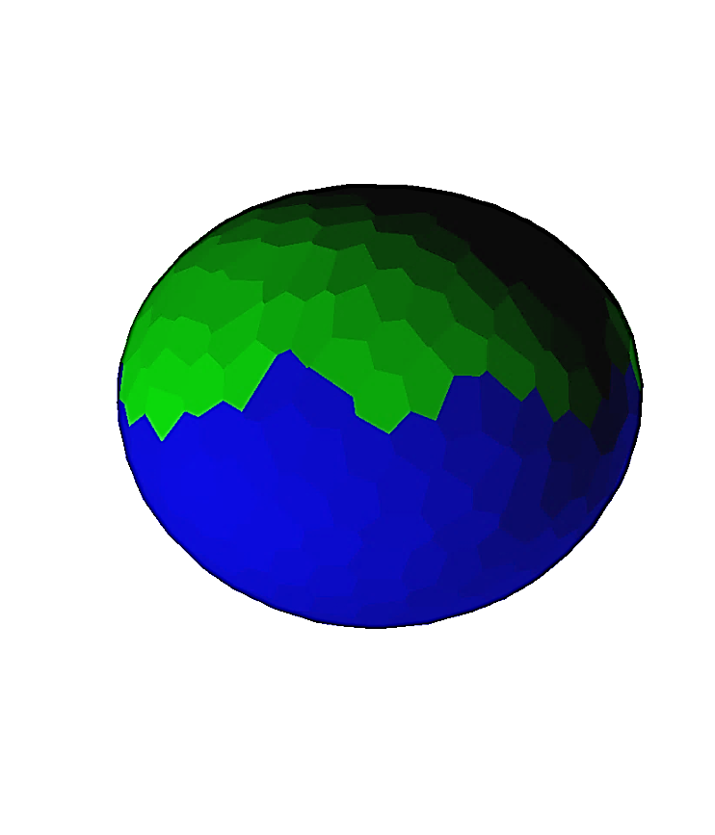
Controlled curvatures
Notes:
OTOH, slap together the two actuators, hook up in a very simple control loop w/hybrid curvature sensor, right away, p. nice results
Green region of fig controlled curvature. Three different target values.
So, took several years to realize this!
AB cell shape change only: tendency to buckle cylindrically, tearing instabilities, snap-thru instability
Trouble with ABC: mech. instabilities if cells doesn’t flow accordingly
Traction only: Barely budges (& instabilities if pushed *really* hard on open boundaries)
Trouble with traction intercalation: rearrangement of cells promotes relaxation. Like jiggling a bottle of ketchup. Loses its strength. Works at cross purposes. Bending resistance drives out curvature.
Combine traction + shape change, worked like magic.
Not an accident. Vary parameters, still works well.
Now relaxation works in our favor, damping out irregularities and instabilities, driving system towards rather than away from target structure.
3rd example of P.R.
Different handles on high dimensional, a cross-constrained system. Grab several. Shake up.
(Rely on autonomous energy-min dynamics to keep uninteresting DoFs stable)

Slide 13
Combining pieces: Relaxation
How to paste parts together?
Decouple from each other
Key technique: Active relaxation
(also using traction)
Or 3-arm and graph? (cut next slide, even?)
Notes:
Now we have simple feature controller: sph curvature
Want to build complex things from simple pieces
Whole idea of a body plan
Problem: different parts have their own incompatible constraints
Not necc. match up at boundaries
As part forms, exerts large forces on neighbors
Like to put parts together while decoupling from each other
How?
Ideally: “Interpolate”
How? (again) relax mechanical energy
Vid: active smoothing w/traction (2nd derivative of gaussian curvature) ¶
(Can also do by random grappling.)
Combiner
Gen. principle: control a few important degrees of freedom. Coax the others to relax passively.

Slide 14
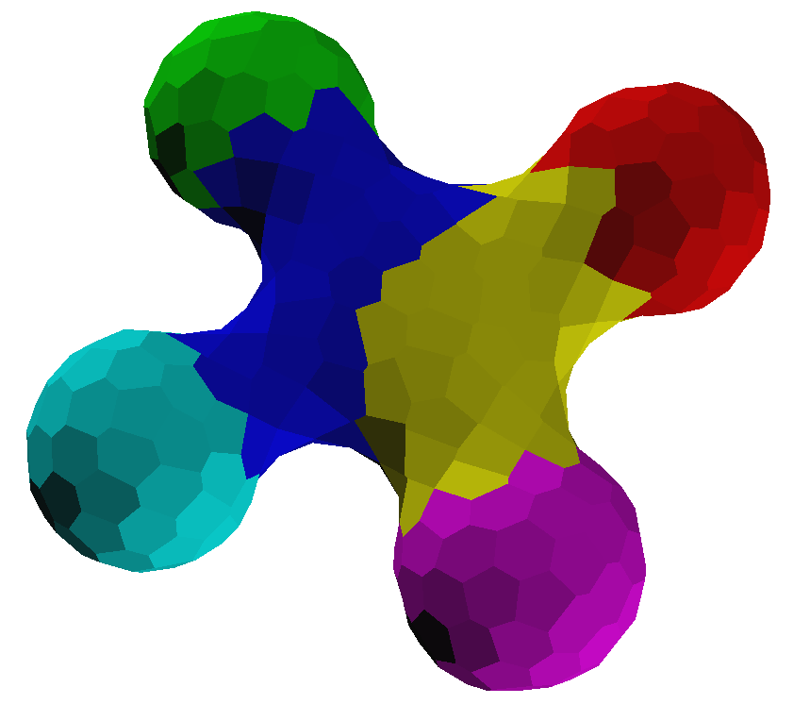
Compound structures
2
4
4
1
2
1
6
3
3
5
Notes:
Example compound structures.
Top: body plan graph
Bottom: Resulting structure
Show development for L ¶
Very nice, a bit wobbly (oscillatory), self-correcting.
Drawback: combiner appears to be associative. Consequence of relaxation.
Sort of exactly what we wanted, but nice to have more control

Slide 15
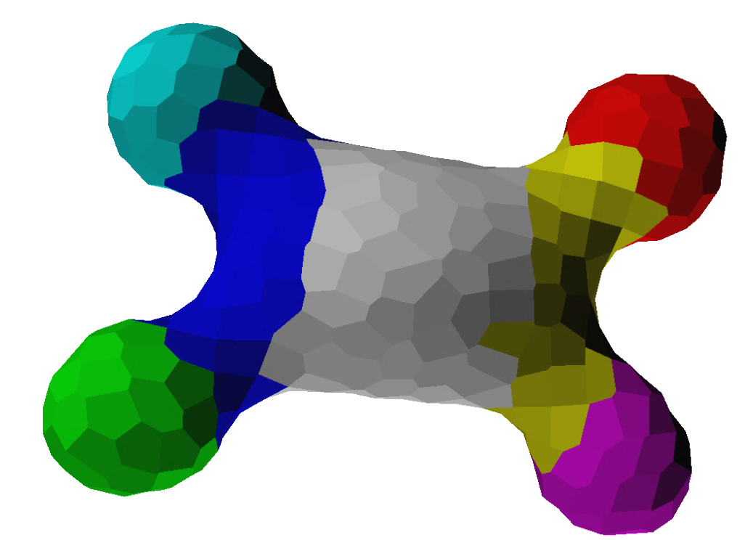
Breaking associativity
2
4
2
4
3
1
7
6
1
6
5
3
5
Notes:
Make things a little more complex by adding differential adhesion between regions
Trajectory for L. ¶
Interesting…

Slide 16
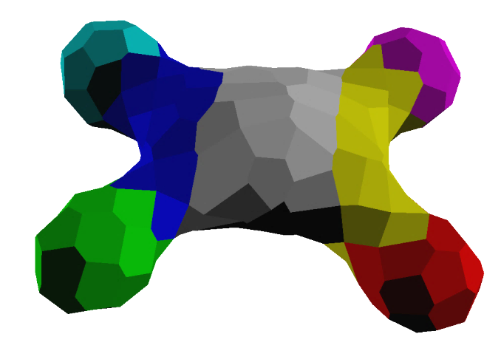
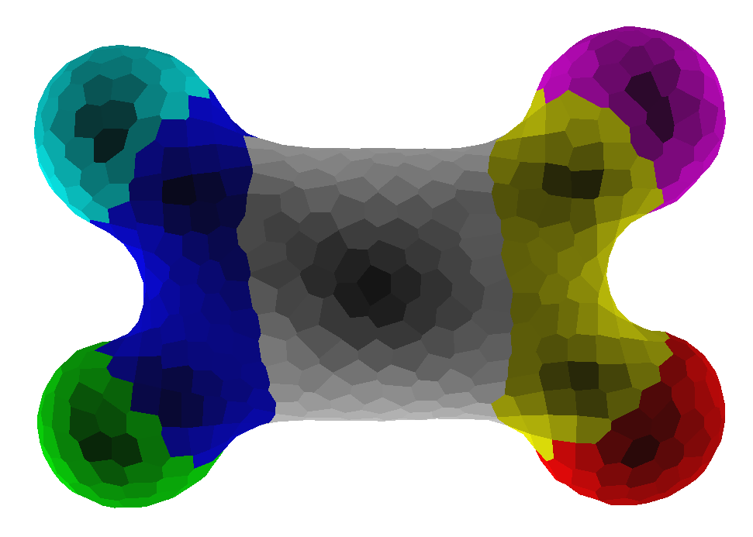
How robust is it?
Notes:
How robust is it? Do we really need all that redundancy?
Algo as described handles:
Order of magnitude in size (thanks to hybrid sensor). (Some caveats, see paper)
Order of magnitude variation in substrate bending stiffness (flexural rigidity)

Slide 17
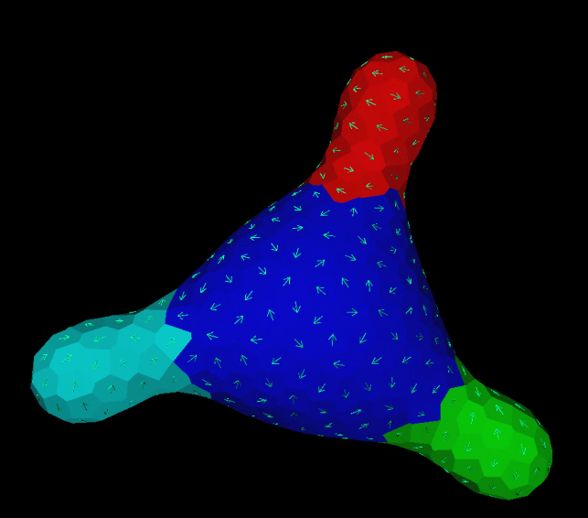
How robust is it? (2)
Vary substrate properties
Stiff: works w/o traction
Default: requires both
(or at least traction relaxation)
Soft: sometimes works w/o either
Notes:
OTOH, if we remove either actuator, things degrade quickly. Range of applicability collapses.
Only works w/certain stiffnesses, and only for some patterns. Results less reliable, complex structures often fail.
Partial redundancy crucial for solving the problem well.

Slide 18
Recap: Mechanism summary
Closed-loop control everywhere
Body plan patterning: Constraint propagation
Geometric sensing
Feature actuation: Traction & bending
Combination by relaxation
Notes:
Recap:
Strategy treats morpho as homeostasis
Closed loop control everywhere
Body plan patterning
Geometric sensing & actuation
Composition according to plan by decoupling thru relaxation

Slide 19
Recap: Partial redundancy
Actuator
Goal specification
Actuator
Spatial structures
Actuator
Sensor
Sensor
Sensor
3 examples:
Body plan patterning
Geometry sensing
Geometry actuation
Benefits: Speed, Design complexity, Robustness, Range of applicability
Solved problems that otherwise resisted solution
Notes:
Common theme again and again: partial redundancy
Simplifies design problem
Speed, robustness, range of applicability
Interesting to try to apply to engineering
Also interesting to speculate in nature
In nature, species might evolve in one narrow set of conditions, then add more mechanisms to broaden ecospace
Pick one then pile on
Explain why dev. investigations such as knock-out studies so notoriously confusing

Slide 20
Selected references
Foam-inspired modeling
Radhika Nagpal, Ankit Patel, and Matthew C. Gibson. Epithelial topology. BioEssays, 30(3), 2008.
Xiaoguang Chen and G Wayne Brodland. Multi-scale finite element modeling allows the mechanics of amphibian neurulation to be elucidated. Physical Biology, 5(1):015003, 2008.
G. Wayne Brodland. Do lamellipodia have the mechanical capacity to drive convergent extension? International Journal of Developmental Biology, 50:151-155, 2006.
Computational patterning models
Jacob Beal. Functional blueprints: An approach to modularity in grown systems. In International Conference on Swarm Intelligence, 2010.
R. Doursat. Programmable architectures that are complex and self-organized: from morphogenesis to engineering. In S. Bullock, et. al., eds., ALIFE XI, p. 181-188. MIT Press, 2008.
Daniel Yamins. A Theory of Local-to-Global Algorithms for One-Dimensional Spatial Multi-Agent Systems. PhD thesis, Harvard, December 2007.
Radhika Nagpal. Programmable Self-Assembly: Constructing Global Shape using Biologically-inspired Local Interactions and Origami Mathematics. PhD thesis, MIT, 2001.
Regeneration
V. French. Pattern regulation and regeneration. Philosophical Transactions of the Royal Society of London. B, Biological Sciences, 295(1078):601-617, 1981.
Jay E. Mittenthal. The rule of normal neighbors: A hypothesis for morphogenetic pattern regulation. Developmental Biology, 88(1):15-26, 1981.
Hans Meinhardt. Biological pattern formation as a complex dynamic phenomenon. In Alessandra Carbone, Misha Gromov, and Przemyslaw Prusinkiewicz, eds., Pattern Formation in Biology, Vision, and Dynamics, p. 99-132. World Scientfic, 2000.
Notes:
Thanks!

Slide 21
Questions?

