Slide 1
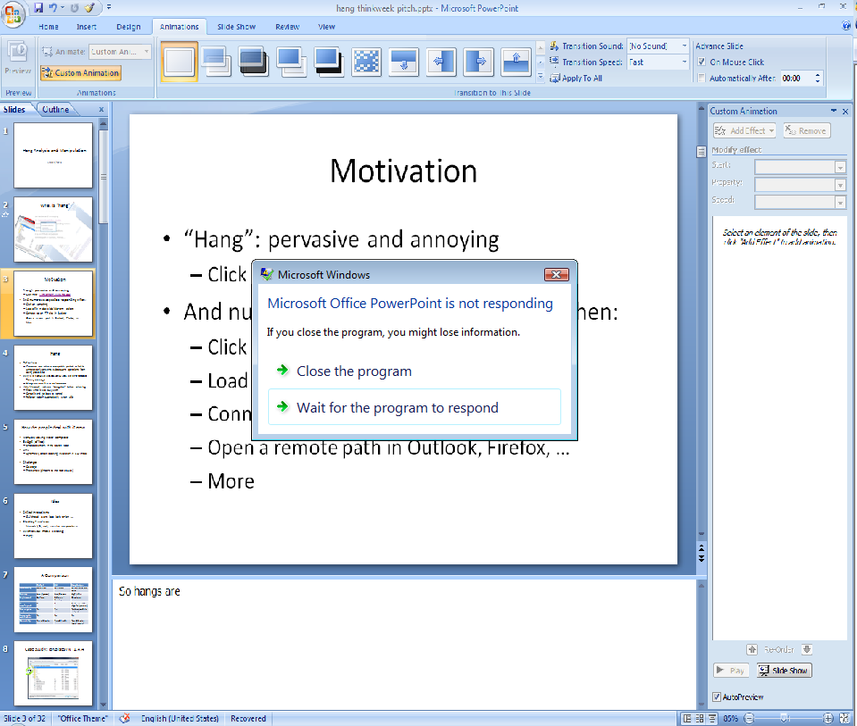

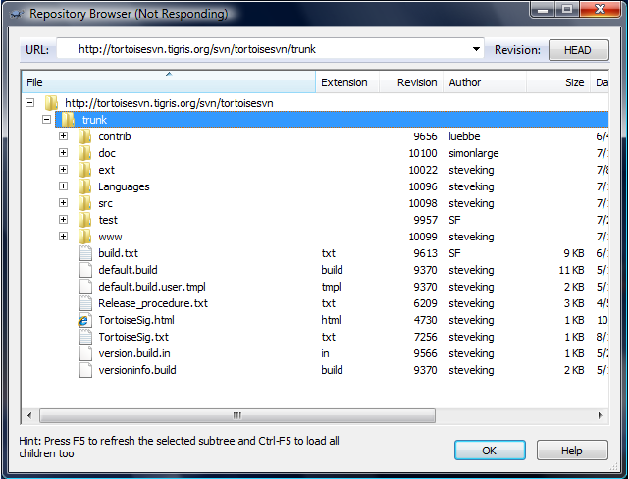
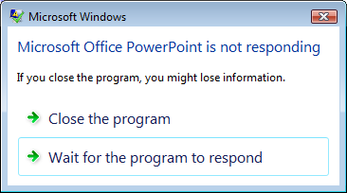
Hang Analysis:
Fighting Responsiveness Bugs
Xi Wang, Zhenyu Guo, Xuezheng Liu, Zhilei Xu, Haoxiang Lin, Xiaoge Wang, Zheng Zhang
System Research Group
Microsoft Research Asia

Slide 2
Motivation
Numerous responsiveness problems in software
  Click on something
  Load a large/remote file in editors
  Etc…
Hang
  A painfully long time before responding again
  Unable to cancel
  Goal
    Detect and eliminate hang bugs from complex software
Notes:
I am sure all the scenarios in previous picture are familiar to you. Actually, we all run into the problem of responsiveness. For instance, when we …. the app stops responding, taking a long time to come back. Meanwhile you cannot cancel. This is what we called HANG. Therefore, our goal is …

Slide 3
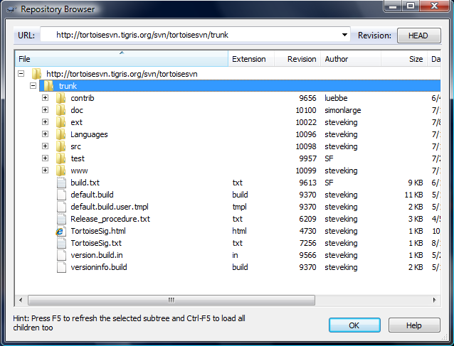
Example: TortoiseSVN
Notes:
Here is a very popular revision control client called TortoiseSVN, and when people click to expand the directory on a remote machine, it hangs!

Slide 4
Example: TortoiseSVN

Slide 5
Example: TortoiseSVN
TortoiseSVN
CRepositoryBrowser::OnTvnItemexpandingRepotree (RepositoryBrowser.cpp:1170)
CRepositoryBrowser::RefreshNode (RepositoryBrowser.cpp:1012)
SVN::List (SVN.cpp:1608)
subversion
svn_client_list2 (libsvn_client:list.c:110)
svn_ra_get_dir2 (libsvn_ra:ra_loader.c:576)
svn_ra_dav__get_dir (libsvn_ra_dav:fetch.c:808)
svn_ra_dav__get_props (libsvn_ra_dav:props.c:481)
svn_ra_dav__parsed_request (libsvn_ra_dav:util.c:1176)
svn_ra_dav__request_dispatch (libsvn_ra_dav:util.c:1306)
Message
Looping
neon
ne_request_dispatch (ne_request.c:1394)
ne_begin_request (ne_request.c:1200)
ne_sock_fullwrite (ne_socket.c:699)
OS
OS
send
Blocking network I/O in the UI thread
Critical running context: UI callback invocation
Blocking operation: send
Notes:
What happened here is that the message handler bound to the click operation eventually talks to the network via a blocking call ‘send’.

Slide 6
What is a hang?
Hang
  Can be caused by lots of reasons
  Many of the are soft-hangs: eventually back to control
Usually not a correctness bug, but caused by a problematic coding style
  Carelessly long-time operations in a critical thread context
  Exist in both client apps and event-driven servers
A recent product survey shows that user complaints of hangs are getting close to the percentage of crashes
  And an important share of crashes are actually caused by users terminating a hanging application!

Slide 7
How do people fight with hangs?
Development: enforce coding disciplines
  Disallow any synchronous I/O in GUI thread or lock regions
  Cannot help legacy code and libraries
  Hard to follow: implicit network operations
Detect in test lab: debugging
  Use timing assertions
  Low coverage: hangs are sensitive to environments
Detect by the end user: bug report (e.g., Watson)
  Damages are already made
  Not always possible
  Limited information: hard to find root cause
Notes:
So how do we deal with hang today?
Some product team is taking a new initiative, they embed … an example is that UI thread can never invoke a network I/O.
While this discipline is restricted to office team right now, others try to detect hangs in test lab, using tools such as AHV from Fundamental Testing Group. Since these tools only perform random and dynamic testing, they have low coverage. Most importantly, hangs are sensitive to environments, e.g. low bandwidth network, which cannot be reproduced in a lab.
Due to this low coverage, we also incorporate end-user tools such as Watson to collect data about hangs. However, in that case, damages are already done.
[Development]
An intuitive ways is to enforce coding disciplines at developing time. This is already adopted, e.g., disallow …
While it’s good for a new system built from a scratch, this approach cannot solve hangs in legacy systems and libraries.
Even worse, as we will see later, many network I/O are implicit, and legacy libraries doesn’t have time-spec for the users. So it’s hard for developers to follow the rule without mistakes.

Slide 8
Basic Idea
Static analysis
Critical invocations
  UI threads, event loops, lock regions…
Blocking functions
  Network I/O, wait, long loop…
When critical meets blocking
  Hang!
Critical Invks
Source Code
Hang Bugs
Static Analysis Engine
Blocking Invks
Critical & Blocking Patterns
Notes:
[connecting]
Given these limitations of existing approaches, we need a systematic way to detect hangs and eliminate them as early as possible.
We use static analysis
While all those previous work do fancy work, our idea is quite simple. We use static analysis to identify invocations that really matters to end user experience, and we call them critical invocations. Examples are …
At low level, we also know that some functions will blocking, such as ….
And when critical meets blocking, BANG! There is a HANG! And we catch it at the very first beginning.

Slide 9
Call graph reachability
Can a critical entry reach a blocking sink on a call graph?
Critical entry: message handler
a
i₁
i₂
b
i₃
c
i₄
i₅
d
i₆
i₇
e
f
i₈
i₉
g
send()

Slide 10


A complex hang case
GIMP
void file_open_dialog_response (GtkWidget *open_dialog, ...) {
uris = gtk_file_chooser_get_uris (GTK_FILE_CHOOSER (open_dialog));
for (list = uris; list; list = g_slist_next (list)) {
gchar *filename = file_utils_filename_from_uri (list->data);
if (g_file_test (filename, G_FILE_TEST_IS_REGULAR))
GLib
g_file_test(filename)
OS
GetFileAttributesW(filename) / stat(filename)
kernel
network connection
(filename is remote)
Implicit blocking network I/O for a network path
NOT all invocations to GetFileAttributesW/stat are blocking:
It is blocking if the filename is remote
Notes:
While previous example is simple, here is a complex file. This case is about GIMP, an open source graphics editor. The code here has a couple of file system calls, deep in the call stack eventually. Depends on whether those I/Os are local or network, you can have hang. For instance, if this path points a remote file on the internet, the subsequent call to file_test, and eventually GetFileAttributes, will have a hang. So, that means that our analysis must be aware of the context, to distinguish different result due to different parameters.

Slide 11
A complex hang case (cont.)
filename = “./app.config”
void load_config_file(...) {
filename = get_config_file_name(...);
g_file_test(filename, G_FILE_TEST_IS_REGULAR);
g_file_test(filename)
GetFileAttributesW(filename) / stat(filename)
kernel
(filename is local)

Slide 12
Context Sensitivity and conditional blocking
UI func
file_open_dialog_response
load_config_file
P1: filename may be remote
P2: filename is local
GetFileAttributesW/stat
Conditional blocking: decided by the parameter

Slide 13
Goals
Expressiveness & Extensibility
  Complex blocking conditions
  Incorporate various domain-specific knowledge
Context sensitivity
  Reduce false alarms
  Scale to large software (> 1M LoC) with acceptable precision
Notes:
This analysis system should be open to patterns.
Developers of different applications focus on different patterns: GUI app – UI threads; web server – dispatch threads; …
And/or Boolean functions for conditions, and express them in Datalog rules.
Only developers know it, so the framework should be designed to incorporate expert knowledge easily.
[Scalability vs. precision]
There is a general tradeoff between Scalability and Precision in static analysis.
We need to perform reasonable approximation to improve scalability, at the same time alleviate false positive/negative
Reduce false positive is more important than avoiding false negative (in another word, making the analysis “sound”).
Because of the nature of “hang” problem: to some extent a user can tolerate a hang bug that occurs rarely; but developers cannot use a tool that reports like thousands of incorrect hang bugs which bury down the real hangs.
This means that we need to be conservative.

Slide 14
Overview
Motivation
Design decisions
System design
  Clone-based context-sensitive analysis
  Representation in database queries
  Critical patterns
  Blocking patterns
  Post processing
Evaluation
Discussions

Slide 15
Framework
Source Code
All function invocations
Compiler plug-in (Phoenix in VC)
Critical Invocations
Hang Invocations
Hang Reports
Critical Patterns
Blocking Patterns
Post Processing
Notes:
Take the source code, we find all the invocation via Phoenix which is a compiler, then find those that matters, which are critical invocations, and then refined further for those blocking ones. To reduce false positive, we also take the unblocking patterns and the final set is those should really produce hangs.

Slide 16
Program analysis as database queries
Invocations
  DB tables manipulated by queries
Patterns
  DB queries that can be incrementally added
Efficient implementation using Binary Decision Diagram (BDD)
  Compact and compressed format in storage
    Known to scale to analyze 10²³ call paths
  Good performance for the operations used in our analysis

Slide 17
Generate context-sensitive function invocations
  Call graph construction: call(f, g) if f calls g
  Direct call
  Indirect call (function pointers)
  Implicit call (OS callback)
Clone-based context sensitive analysis
  Clone each function in different call paths as different invocations
  Evaluate blocking conditions on each cloned invocation

Slide 18
Context Cloning
a
a₀
i₁
i₂
(i₁, 0)
(i₂, 0)
b
i₃
c
b₀
(i₃, 0)
c₀
(i₄, 0)
(i₅, 0)
i₄
i₅
d
d₀
d₁
d₂
i₆
i₇
(i₆, 0)
(i₆, 1)
(i₆, 2)
(i₇, 0)
(i₇, 1)
(i₇, 2)
e
f
e₀
e₁
e₂
f₀
f₁
f₂
i₈
i₉
(i₈, 0)
(i₈, 1)
(i₈, 2)
(i₉, 0)
(i₉, 1)
(i₉, 2)
g
g₀
g₁
g₂
g₃
g₄
g₅
Notes:
strongly connected components (i.e. direct or indirect recursive calls) are reduced into one node, and a clone is made for each call path.

Slide 19
Generate critical invocations
Critical entries
  UI threads function
  Event/message dispatcher
  Event/message handler
  Others (added by developers)
Reachability analysis through recursive query
  Start from a critical entry (e.g., UI thread function)
  Reach(f) :- call(“wWainMain”, f).
  Reach(f) :- Reach(g), call(g, f).
Automatically extract critical entries
  Use coding conventions, source code annotations
  Dynamically trace function calls and check the executing thread
Notes:
Goal: prune invocations that are not critical

Slide 20
Examples of critical entries
BEGIN_MESSAGE_MAP(CRepositoryBrowser, CResizableStandAloneDialog)
ON_BN_CLICKED(IDHELP, OnBnClickedHelp)
ON_WM_SETCURSOR()
ON_REGISTERED_MESSAGE(WM_AFTERINIT, OnAfterInitDialog)
ON_WM_MOUSEMOVE()
ON_WM_LBUTTONDOWN()
ON_WM_LBUTTONUP()
ON_NOTIFY(TVN_SELCHANGED, IDC_REPOTREE, &CRepositoryBrowser::OnTvnSelchangedRepotree)
ON_NOTIFY(TVN_ITEMEXPANDING, IDC_REPOTREE, &CRepositoryBrowser::OnTvnItemexpandingRepotree)
ON_NOTIFY(NM_DBLCLK, IDC_REPOLIST, &CRepositoryBrowser::OnNMDblclkRepolist)
ON_NOTIFY(HDN_ITEMCLICK, 0, &CRepositoryBrowser::OnHdnItemclickRepolist)
ON_NOTIFY(LVN_ITEMCHANGED, IDC_REPOLIST, &CRepositoryBrowser::OnLvnItemchangedRepolist)
ON_NOTIFY(LVN_BEGINDRAG, IDC_REPOLIST, &CRepositoryBrowser::OnLvnBegindragRepolist)
ON_NOTIFY(LVN_BEGINRDRAG, IDC_REPOLIST, &CRepositoryBrowser::OnLvnBeginrdragRepolist)
ON_WM_CONTEXTMENU()
ON_NOTIFY(LVN_ENDLABELEDIT, IDC_REPOLIST, &CRepositoryBrowser::OnLvnEndlabeleditRepolist)
ON_NOTIFY(TVN_ENDLABELEDIT, IDC_REPOTREE, &CRepositoryBrowser::OnTvnEndlabeleditRepotree)
ON_WM_TIMER()
END_MESSAGE_MAP()
Notes:
This is a example of critical patterns. Functions are registered as message handlers is GUI thread, then those function invocations and their child invocations are critical.
[pattern extraction]
They can be either annotated by developers, as SAL annotation, or dynamically traced by tracking function calls.

Slide 21
Framework
Source Code
Call graph, variable tables
Compiler plug-in (Phoenix in VC)
Critical Invocations
Hang Invocations
Hang Reports
Critical Patterns
Blocking Patterns
Post Processing
Notes:
Goal: prune critical invocations that are not blocking

Slide 22
Blocking patterns
Blocking syscalls
  Synchronous network operations
Conditional blocking functions
  File operations: file name may-remote
  Sleep as “yield”: the sleeping time may-zero
  Socket API: synchronous or asynchronous
Notes:
The idea is similar, we input blocking patterns. And here is some examples: calls to networking I/O, long loops, etc. Once an invocation is both critical and blocking, it is hang. Therefore, the goal in this phase is to prune invocations that never blocks.

Slide 23
Conditional Blocking Patterns
property | example | description | condition
may-remote | GetFileAttributesW( lpFileName) | get file information | lpFileName is remote
may-nonzero | Sleep( dwMilliseconds) | sleep for an interval | dwMilliseconds is nonzero
may-null | TransmitFile( …, lpOverlapped, …) | send file data over a socket asynchronously, or synchronously if lpOverlapped is null | lpOverlapped is null
blocking(invk) :- call(invk, "GetFileAttributesW"),
param(invk, 1, v), may_remote(v).
may_remote stores all may-remote parameters in all contexts
Notes:
Sleep(0) as a common trick in spin lock

Slide 24
Post processing
Merge common hang path
Rank bugs
  Hang gates: first external (library) function
TortoiseSVN
CRepositoryBrowser::OnTvnItemexpandingRepotree (RepositoryBrowser.cpp:1170)
CRepositoryBrowser::RefreshNode (RepositoryBrowser.cpp:1012)
SVN::List (SVN.cpp:1608)
subversion
svn_client_list2 (libsvn_client:list.c:110)
svn_ra_get_dir2 (libsvn_ra:ra_loader.c:576)
svn_ra_dav__get_dir (libsvn_ra_dav:fetch.c:808)
svn_ra_dav__get_props (libsvn_ra_dav:props.c:481)
svn_ra_dav__parsed_request (libsvn_ra_dav:util.c:1176)
svn_ra_dav__request_dispatch (libsvn_ra_dav:util.c:1306)
neon
ne_request_dispatch (ne_request.c:1394)
ne_begin_request (ne_request.c:1200)
ne_sock_fullwrite (ne_socket.c:699)
OS
send
Notes:
Hang gates are where app developers would be interested (for bug fix, or ask library developers to fix)
Merge common hang paths captured on more than one invocations by different patterns
Bug ranking
Future work: feed the call path to model checkers for feasibility test

Slide 25
Experiments
 | LoC (K) |  |  | Modules |  | Description
 | Internal | External | total | Main | Plug-ins
TortoiseSVN (1.4.5) | 254 | 918 | 1,172 | 5 | 1 | Network client
GIMP (2.4.0) | 864 | 198 | 1,062 | 1 | 167 | Graphics editor
Lighttpd (1.5.0) | 62 | 311 | 373 | 1 | 42 | Web server

Slide 26
Results
 | Analysis time | Hang paths | False Warnings | Hang
 |  |  |  | path | Gate
TortoiseSVN | 17m30s | 229 | 77 | 152 | 26
GIMP | 1h29m57s | 69 | 35 | 34 | 10
lighttpd | 3m19s | 33 | 9 | 24 | 10
Total | - | 331 | 121 | 210 | 46
Annotation on Win32 APIs
Scale to 1M+ lines of code
Average precision: > 60%

Slide 27
Case study: TortoseSVN
Network I/O in UI threads
Implicit specification (subversion API)
Deep on call paths (~8)
Hit | Gate | Bottom | ⊤/⊥
24 | svn_client_open_ra_session | connect | 3/7
17 | svn_client_proplist2 | connect | 3/8
15 | svn_client_cat2 | connect | 5/8

Slide 28
Lessons learned
Implicit blocking functions deep in call paths
  Network I/O: connect
  Sleep for several seconds in product code
Evolving design
  GetFileAttributesW/stat for testing a path
  Should have a timeout in API
  Remote access to printers block system print dialogs
Load complex files in UI threads
  Most editors
  Especially in plug-in based design
Other experience (in the paper)

Slide 29
Limitations and possible extensions
Nonblocking I/O
  Track creation parameters
  But the usage can be very complicated
Lock contention
  Propagate critical invocations to other threads
Signal-Wait
  Propagate critical invocations to triggers
  Use dynamic tracing to extract relationship between triggers and wait
Notes:
Several Windows socket API functions (e.g., WSAAsyncSelect) automatically sets a socket to nonblocking mode. Current impl uses a conservative way…
Wait and lock are not discouraged in critical threads….

Slide 30
Related Work
Interactive performance measurement (TPIME)
Termination verification / halting problem (Terminator)
Web server design
  Avoid blocking calls in event loops
SQL injection
  Similar analysis approach
Notes:
TPIME, SIGMETIRCS 00, Harvard
Terminator, PLDI 06/07, MSR Cambridge
Flash, USENIX 00/04, Rice
userver, EuroSys 07, Waterloo
SQL injection: similar graph reachability

Slide 31
Conclusions
Hang problems are pervasive in complex software
  Implicit blocking call in external library
  Unclear API spec
  Plug-ins for composability
  Evolving design
Static analysis is useful for hang problems
  Find needles in a haystack
  Call for API timing spec

Slide 32
Future Work
Lock contentions
Automatically extract blocking conditions
Feasibility testing

Slide 33
Thanks!
Questions?

Slide 34
A Comparison
 | Code Discipline | Runtime Detector | Hang Analysis
Functionality | Detection | Detection | Detection & root cause
Coverage | Low (dynamic) | Low (dynamic) | High (static)
False positive (over-report) | Yes | No | Yes/Low (multi-stage for pruning)
False negative (miss) | Yes | Yes | Yes/Low
Source code modification | Yes | No | No
Extensibility | Yes, add code | Yes, add code | Yes, add patterns (much easier)
Notes:
Ok, so as a conclusion
Just say builds complete invocations.
Now that,,,, we do….
Simple blocking API calls…
As I mentioned earlier….. some blocking is context sensitive
We have applied this on a number of ….
A comparison between budget, AHV Hang….
In terms of functionality, in addition to detect, we also report the root cause
Because we are using static analysis, our coverage is high
We might have FP, but we can refine by adding more rules in the stages
In theory, we should not have any misses. However, today’s software are composed by lots of modules, and perform static
analysis across modules could be challenge.
We need no source code modification
As I mentioned, this system can be incrementally improved by simply adding rules
We see this actually is complementary to what other tools. For instance: AHV can help us to define better patterns. These
patterns can supply to Budget also at coding time.

Slide 35
Binary Decision Diagram
Graphical encoding of a truth table.
x₁ | x₂ | x₃ | f
0 | 0 | 0 | 1
0 | 0 | 1 | 0
0 | 1 | 0 | 0
0 | 1 | 1 | 1
1 | 0 | 0 | 0
1 | 0 | 1 | 1
1 | 1 | 0 | 1
1 | 1 | 1 | 1

Slide 36
Binary Decision Diagram
x₁
0 edge
1 edge
x₂
x₂
x₃
x₃
x₃
x₃
1
0
0
1
0
1
1
1

Slide 37
Binary Decision Diagram
x₁
0 edge
1 edge
x₂
x₂
x₃
x₃
x₃
x₃
1
0
0
1
0
1
1
1

Slide 38
Binary Decision Diagram
x₁
0 edge
1 edge
x₂
x₂
x₃
x₃
x₃
x₃
0
1
Notes:
The 2nd and the 3rd x3 are the same and can be merged.
The 4th x3 can be omitted, allowing its parent x2 directly connect to 1.

Slide 39
Binary Decision Diagram
x₁
0 edge
1 edge
x₂
x₂
x₃
x₃
x₃
0
1
Notes:
The 4th x3 can be omitted, allowing its parent x2 directly connect to 1.

Slide 40
Binary Decision Diagram
x₁
0 edge
1 edge
x₂
x₂
x₃
x₃
0
1

Slide 41
bddbddb
Whaley & Lam, PLDI ’04
Analysis engine used by HangWiz
Relations → Boolean functions
  D₁ × D₂
  000 00 0
Relation ops → Boolean function ops
  ⋈, ∪, select, project
  ∧, ∨, −, ∼
Notes:
D1 is a domain of size 2^3 (3 bit), and D2 is a domain of size 2^2 (2 bit). If a tuple (d1, d2) exists, f(d1, d2) = 1.

Slide 42
Phoenix IR
_ne_sock_close (State: Hir)
$L1: (references=0) #1358
{*StaticTag}<15>, {*NotAliasedTag}<13>, {*UndefinedTag}<14> = START _ne_sock_close(T) #1358
_ne_sock_close: (references=1) #1358
_sock<16> = ENTERFUNCTION #1358
{Virtual:-12}<1> = CHI {*StaticTag}<15>, {Virtual:-12}<14> #1358
ENTERBLOCK ScopeSymbol267 #1358
ENTERBLOCK ScopeSymbol269 #1358
ENTERBLOCK ScopeSymbol271 #1358
t272 = ADD _sock<16>, 216(0x000000d8) #1362
t273 = COMPARE(NE) [t272]*<1>, 0(0x00000000) #1362
CONDITIONALBRANCH(True) t273, $L7, $L6 #1362
$L7: (references=1) #1362
ENTERBLOCK #1362
t274 = ADD _sock<16>, 216(0x000000d8) #1363
{*CallTag}<11>, {Virtual:-12}^<7> = CALL* &_SSL_shutdown, [t274]*<1>, {*CallTag}<1>, {Virtual:-12}<1>, $L12(EH) #1363
t276 = ADD _sock<16>, 216(0x000000d8) #1364
{*CallTag}<12>, {Virtual:-12}^<8> = CALL* &_SSL_free, [t276]*<7>, {*CallTag}<7>, {Virtual:-12}<7>, $L12(EH) #1364
EXITBLOCK #1365
GOTO $L6 #1365
$L6: (references=2) #1375
{Virtual:-12}^<3> = PHI {Virtual:-12}^<8>, {Virtual:-12}^<1> #1375
t277 = ASSIGN _sock<16> #1375
t278 = COMPARE(LT) [t277]*<3>, 0 #1375
...
Notes:
Neon HTTP library

Slide 43
Relations
Assignments
  p = c [vC₀]
  p = f [vF₀]
  p = q [assign]
  p = &q [address]
  p = *q [load]
  *p = q [store]
IR: CALL, ADD, …
  I × O × F [IR]
  I × V × Z [src, dest]
Calls
  I × F [call]
  C × I × C × F [cc]
Notes:
Call can be computed from IR (direct call) and vF (indirect call, variable for function pointers)

Slide 44
Blocking Pattern Examples
Blocking API
# If there is an invocation invk to “connect”, it is a blocking invocation.
blocking(invk) :- call(invk, "connect”).
# If there is an invocation invk to “send”, it is a blocking invocation.
blocking(invk) :- call(invk, "send").
Conditional blocking patterns
# If there is a string v from registry or dialogs, it is tainted.
may_remote(v)
# DWORD GetFileAttributes( LPCTSTR lpFileName );
# if there is an invocation ivk to “GetfileAttributesW”,
# and its 1st parameter is v, and v is tainted, it is a blocking invocation.
blocking(invk) :- call(invk, "GetFileAttributesW"),
param(invk, 1, v), may_remote(v).
Notes:
And here is some examples about blocking patterns; developers are allowed to add more in the future. The first rule says that invocations call blocking APIs like “connect”, “send” will be a blocking invocation. The second rule is relatively complex. It says that if an invocation calls API GetFileAttributesW, and the path parameter for this APIs is from registry or dialogs, then this invocation can be a blocking one.

Slide 45
The depth of Blocking API
GetFileAttributesW(lpFileName);
Blocking when the lpFileName is remote.
svn_error_t * svn_client_status(..., const char *path,
..., svn_boolean_t update, ..., svn_client_ctx_t *ctx, ...);
Blocking when the path is remote, or update is true and ctx is remote.
Low level syscalls
  Simple blocking condition, easy to annotate
  Expensive to calculate, far from the real causes for applications
High level API
  Complex blocking condition
  Efficient to calculate, with good information
Prefer a layered approach

Slide 46
A Bigger Picture
Hang Patterns
Bug Report
(rank)
Runtime Monitoring
Static
Analysis
Runtime Manipulation
Code
Refactoring
binary
source
Software
Notes:
So, up to now, what we have is given hang patterns we apply static analysis to software, and produce report about hang bugs with ranks (I will describe the ranks later). To further refine the precision of the analysis, we can use runtime monitoring to collect more data and extract hang patterns, which will also feed to our analysis. Finally, we can use these report to either refactor the code or dynamically cure these hangs at runtime.

Slide 47
How to cure hang bugs?
Code refactoring
Runtime curing
  Cure hangs at runtime for legacy code
  Hard problem: don’t crash the app
Hang Cure based on binary instrumentation
  Run blocking invocation in another thread
  Separate long wait into multiple small waits
Notes:
For runtime manipulation part, we try to cure hangs at runtime, especially for those legacy code. The problem is that the manipulation must be safe so as to prevent program from crashing. We have implement a prototype on top of WiDS BOX. Basically, what we do is to …

