Slide 1
E2EE Meetings at Zoom
MIT 6.858 – 2022.05.05
Max Krohn
@maxtaco / max.krohn@zoom.us

Slide 2
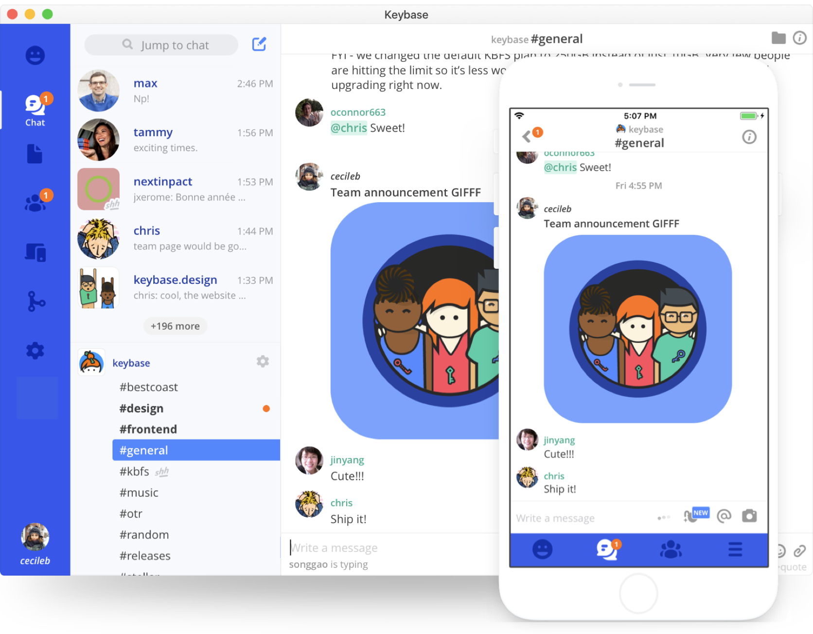
Backstory
Co-founded Keybase in 2015
Built some cool stuff
May 2020: Bought by Zoom
Ever since: using learnings and tech to improve Zoom

Slide 3
Agenda
Some quick background on videoconferencing
End-to-end encryption for Zoom meetings (Phase 1)
Persistent identity (Phases 2+)
Open Q&A

Slide 4
What’s Out There?
TLS
TLS
TLS
Server down-samples video streams

Slide 5
What’s wrong with Point-to-Point Encryption?
TLS
TLS
TLS

Slide 6
Passive Server-Side Attacks
Hard to detect
The attacker is just listening; if good, won’t leave a trace
Many possible attackers
A bad employee (disgruntled, compromised, etc.)
A bad actor with access to the underlying cloud infrastructure
An attacker who gains access to infrastructure past the perimeter
Extremely valuable targets
e.g., a Fortune 500 board meeting
Ukrainian officials + US Senators

Slide 7
What about On-Prem Solutions?
TLS
TLS
TLS

Slide 8
On-Prem Also Has Drawbacks
High latency unless customer deploys global routers
Company might not fully trust the people who change the fried network cards
If buggy, software can become a backdoor into the prem
See: SolarWinds, Log4j, various Microsoft Exchange vulnerabilities

Slide 9
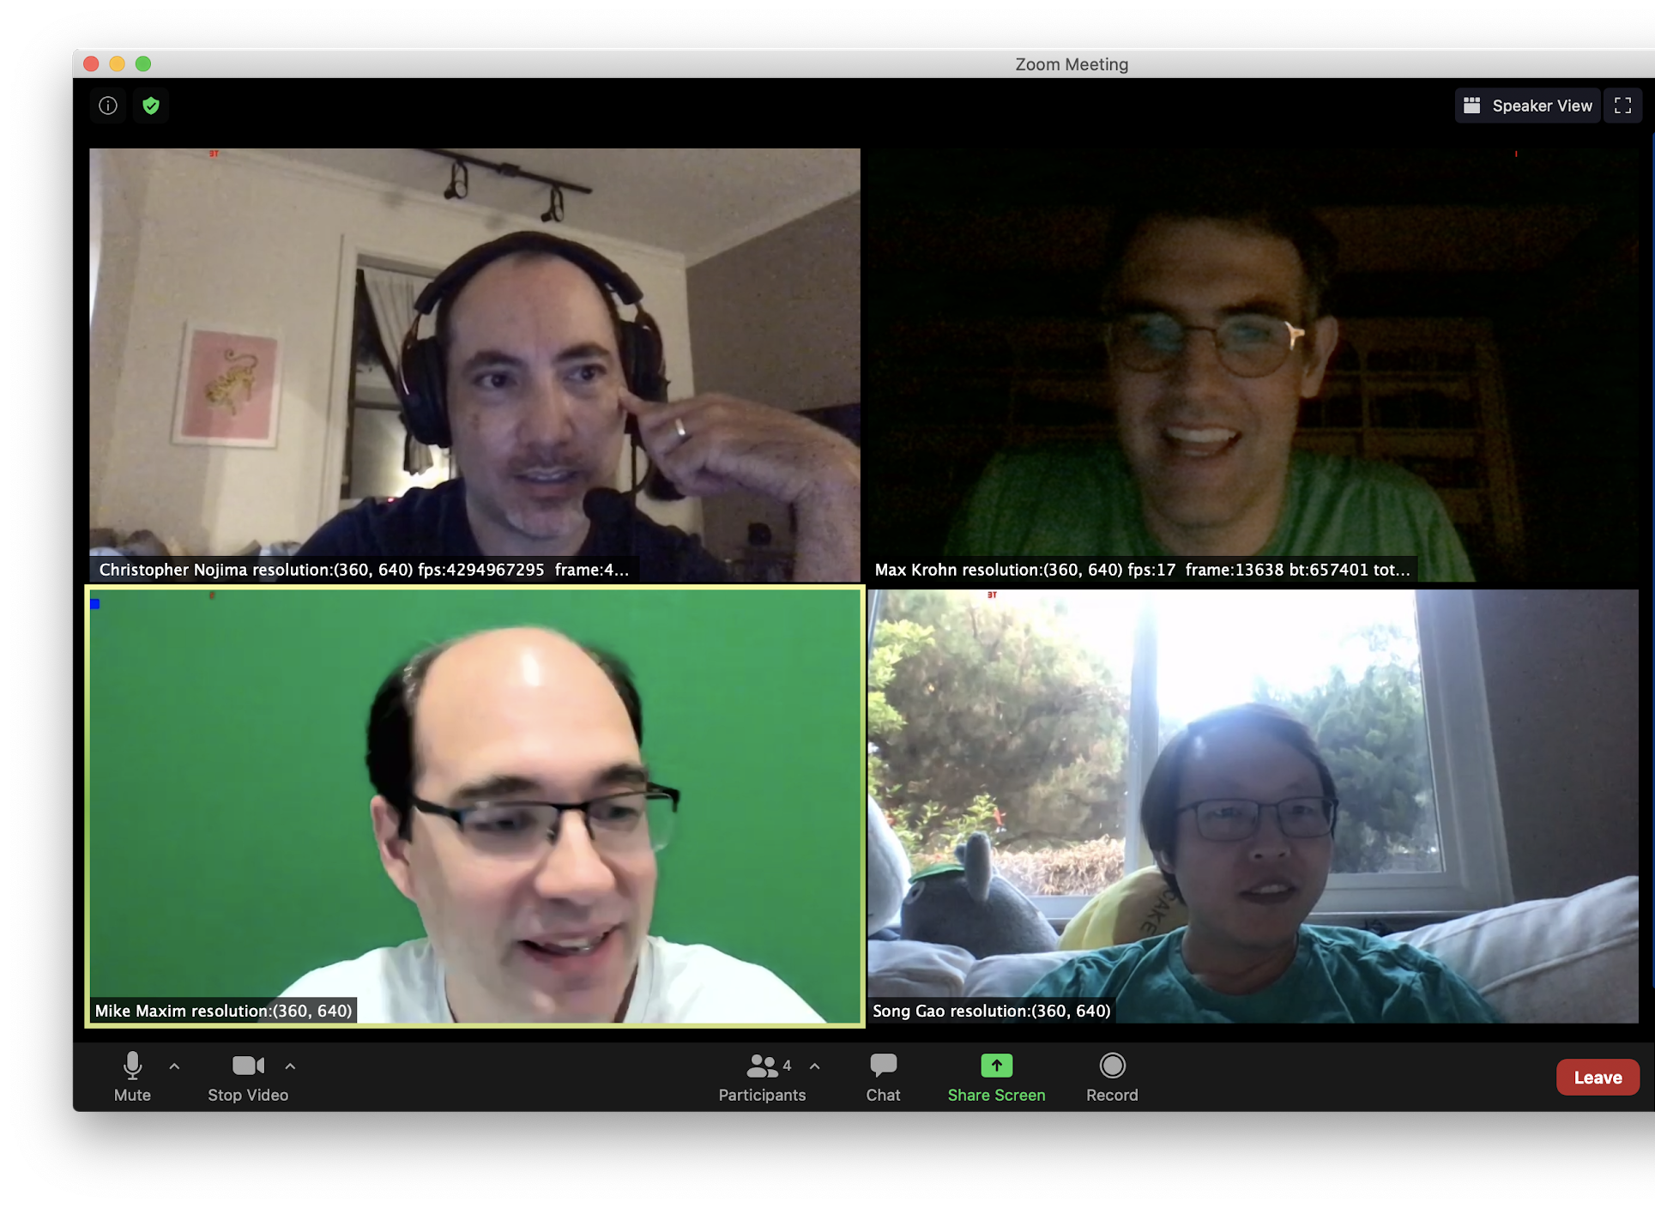
End-to-End Encryption
May 2020
July 2020
First E2EE Meeting
https://github.com/zoom/zoom-e2e-whitepaper
Notes:
In May of last year, our team published a whitepaper detailing a new design for end-to-end encryption (or E2EE) and a strengthened notion of identity for Zoom users.
We opened our design up for public review, and have received a lot of useful feedback from the community.
Since October, just a few months after, we started offering end-to-end encrypted meetings to free and paid users globally.

Slide 10
Enhanced Encryption (simplified)
The server generates and distributes the meeting key (mk) used to encrypt the meeting streams.
Bob
Carol
mk
Alice
Server
Phone

Slide 11
Enhanced Encryption (simplified)
The server generates and distributes the meeting key (mk) used to encrypt the meeting streams
mk
Bob
mk
Encrypted media streams
(AES-GCM)
Carol
mk
Alice
mk
Server
PSTN bridge
(unencrypted)
Phone

Slide 12
End-To-End Encryption (simplified)
Only the communicating parties have the keys to decrypt messages!
mk
Bob
mk
Encrypted media streams
Carol
mk
Alice
mk
Server
Phone

Slide 13
E2EE: Key Generation
Bob
mk₁
Alice
Carol
(leader)
The leader generates the meeting key.
Server

Slide 14
E2EE: Long term device keys
Sig
sk_{B}
Each device keeps a long term signing key pair
Sig
pk_{B}
Bob
mk₁
Sig
Sig
sk_{A}
sk_{C}
Sig
Sig
pk_{C}
pk_{A}
Alice
Carol
(leader)
Broadcast:
Sig
pk_{A}
Sig
pk_{B}
Sig
pk_{C}
Server

Slide 15
E2EE: Ephemeral DH keys
Generate an ephemeral DH key pair: sk ,pk
Enc
Enc
Sig
Enc
sk_{B}
sk_{B}
Sig
Enc
pk_{B}
pk_{B}
Bob
mk₁
Sig
Enc
Sig
Enc
sk_{A}
sk_{A}
sk_{C}
sk_{C}
Sig
Enc
Sig
Enc
pk_{C}
pk_{C}
pk_{A}
pk_{A}
Alice
Carol
(leader)
Broadcast:
Sig
pk_{A}
Sig
pk_{B}
Sig
pk_{C}
Server

Slide 16
E2EE: Ephemeral DH keys
Generate an ephemeral DH key pair: sk ,pk
Sign pk with the device key sk and broadcast
Enc
Enc
Sig
Enc
sk_{B}
sk_{B}
Enc
Sig
Sig
Enc
pk_{B}
pk_{B}
Bob
Enc
pk_{B}
mk₁
Sig
Enc
Sig
Enc
sk_{A}
sk_{A}
sk_{C}
sk_{C}
Sig
Enc
Sig
Enc
pk_{C}
pk_{C}
pk_{A}
pk_{A}
Alice
Carol
(leader)
Enc
Broadcast:
pk_{A}
Enc
Sig
pk_{C}
pk_{A}
Sig
pk_{B}
Sig
pk_{C}
Server

Slide 17
E2EE: Ephemeral DH keys
Generate an ephemeral DH key pair: sk ,pk
Sign pk with the device key sk and broadcast
Enc
Enc
Sig
Enc
sk_{B}
sk_{B}
Enc
Sig
Sig
Enc
pk_{B}
pk_{B}
Bob
Enc
pk_{B}
mk₁
Sig
Enc
Sig
Enc
sk_{A}
sk_{A}
sk_{C}
sk_{C}
Sig
Enc
Sig
Enc
pk_{C}
pk_{C}
pk_{A}
pk_{A}
Alice
Carol
(leader)
Enc
Broadcast:
pk_{A}
Enc
Sig
Enc
pk_{C}
pk_{A}
pk_{A}
Sig
Enc
pk_{B}
pk_{B}
Sig
Enc
pk_{C}
pk_{C}
Server

Slide 18
E2EE: Sharing Meeting Key
The leader A computes a shared key with each participant J
k_{A,J}=DH(sk_{A} , pk_{J} )
And sends them an encryption of mk₁
C_{J} = Enc(k_{A,J} , mk₁)
Enc
Enc
Sig
Enc
sk_{B}
sk_{B}
Sig
Enc
pk_{B}
pk_{B}
Bob
mk₁
Sig
Enc
Sig
Enc
sk_{A}
sk_{A}
mk₁
sk_{C}
sk_{C}
Sig
Enc
Sig
Enc
pk_{C}
pk_{C}
pk_{A}
pk_{A}
Alice
Carol
(leader)
mk₁
Broadcast:
Sig
Enc
pk_{A}
pk_{A}
Sig
Enc
pk_{B}
pk_{B}
Sig
Enc
pk_{C}
pk_{C}
Server

Slide 19
E2EE: Sharing Meeting Key
If someone joins or leaves the meeting, the leader rotates the key
mk₁
Sig
Enc
sk_{B}
sk_{B}
Sig
Enc
pk_{B}
pk_{B}
Bob
mk₁
mk₁
mk₂
Sig
Enc
Sig
Enc
mk₂
sk_{C}
sk_{C}
sk_{A}
sk_{A}
Sig
Enc
Sig
Enc
pk_{C}
pk_{C}
pk_{A}
pk_{A}
Alice
Carol
(leader)
Broadcast:
Sig
Enc
pk_{A}
pk_{A}
Sig
Enc
pk_{B}
pk_{B}
Sig
Enc
pk_{C}
pk_{C}
Server

Slide 20
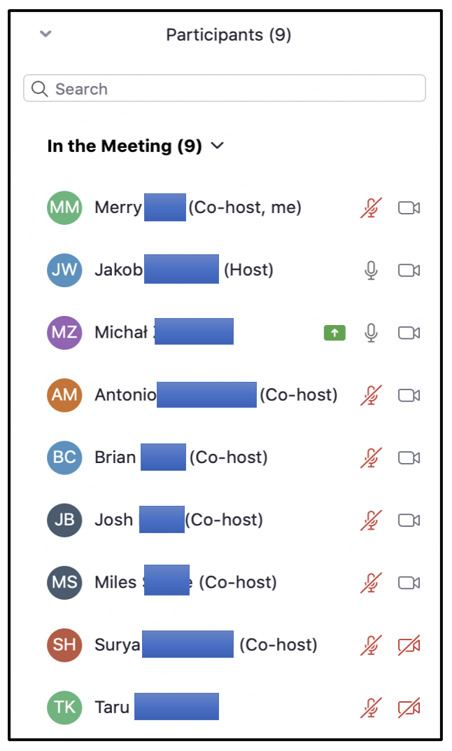
Heartbeats and Participant List
At least every 10 seconds, the leader sends a “heartbeat” which includes:
The current key generation
A list of meeting participants who know this key
In this phase, display names are arbitrary; you can change yours to “🥒🎃🏄‍♀️”

Slide 21
MiTM Attack
Sig
Enc
sk_{B}
sk_{B}
Sig
Enc
pk_{B}
pk_{B}
Bob
mk₁
Sig
Enc
Sig
Enc
sk_{A}
sk_{A}
mk₁
sk_{C}
sk_{C}
mk₁
Enc
Sig
pk_{C}
Sig
Enc
pk_{C}
pk_{A}
pk_{A}
Alice
Carol
(leader)
mk₁
Sig
Enc
Sig
Enc
pk_{E}
pk_{E}
pk_{A}
pk_{A}
Sig
Enc
Sig
Enc
pk_{B}
pk_{B}
pk_{B}
pk_{B}
Sig
Enc
Sig
Enc
Server
pk_{E}
pk_{E}
pk_{E}
pk_{E}
Server

Slide 22
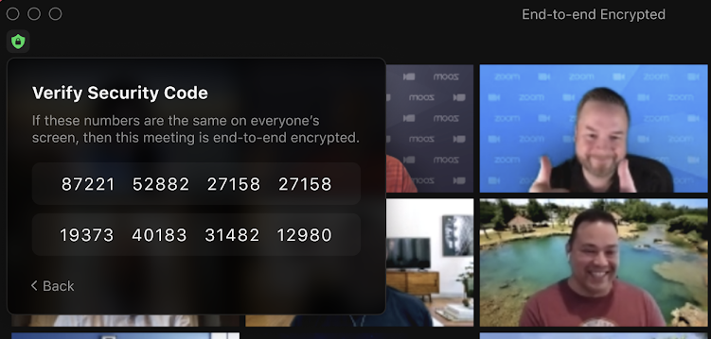
Preventing Meddler-in-the-Middle (MITM)
Meeting leader security code
Leader change notification

Slide 23
MiTM Attack
Sig
Enc
sk_{B}
sk_{B}
Sig
Enc
pk_{B}
pk_{B}
Bob
mk₁
Sig
Enc
Sig
Enc
sk_{A}
sk_{A}
mk₁
sk_{C}
sk_{C}
mk₁
Enc
Sig
pk_{C}
Sig
Enc
pk_{C}
pk_{A}
pk_{A}
Alice
Carol
(leader)
mk₁
Sig
Enc
Sig
Enc
pk_{E}
pk_{E}
pk_{A}
pk_{A}
Sig
Enc
Sig
Enc
pk_{B}
pk_{B}
pk_{B}
pk_{B}
Sig
Enc
Sig
Enc
Server
pk_{E}
pk_{E}
pk_{E}
pk_{E}
Server

Slide 24
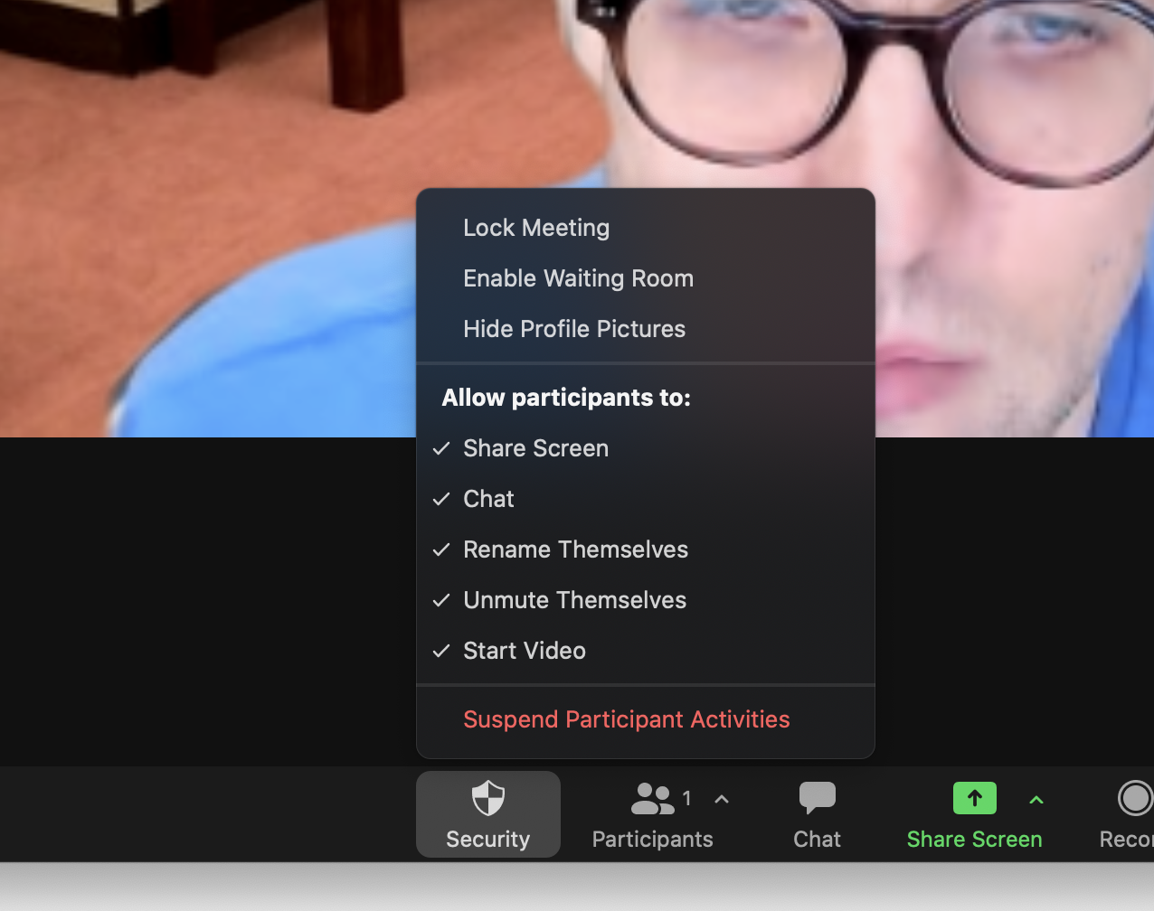
Preventing MITM 2: “Lock The Meeting”
Meeting leader will not key in new participants once meeting is locked.

Slide 25
What attacks can you think of?
Server injects spies into meetings
Deep fakes
Users not exchanging meeting codes or doing it incorrectly
(Join and Drop) x 100
Server tricks user into accessing E2EE via Web
Bad binary

Slide 26
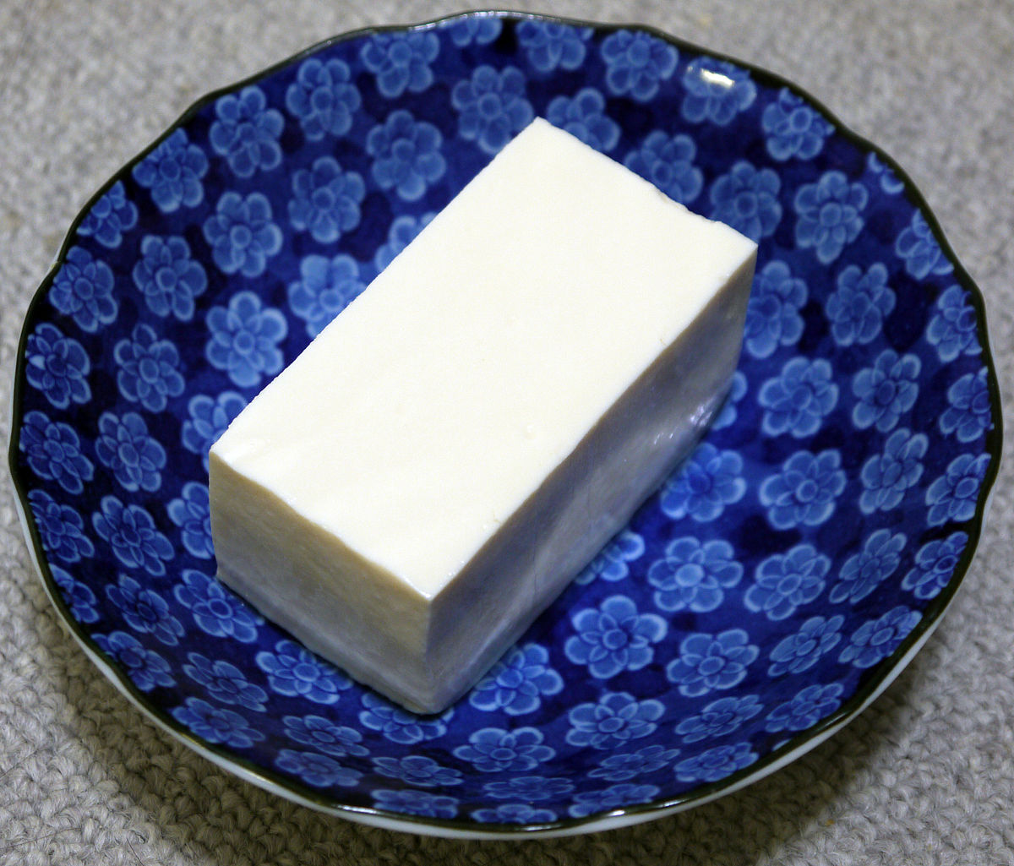
Phase 2+ of E2EE: Better Identity
Participants remember each other’s public keys (TOFU)
Third-party IDPs can independently attest to these identities

Slide 27
Participants Remember Public Keys (TOFU)
You never met with Bob before!
Bob (bob@school.edu)
school.edu (NEW!)
Carol (carol@company.com)
company.com
Alice is on a new device!
Alice (alice@company.com)
company.com (NEW!)
Alex (alex@company.com)
company.com

Slide 28
Problem: Quadratic Warnings

Slide 29
Solution: Personal Device Clouds

Slide 30
Contact Sync
Better security and UX through personal device cloud model.
Clients are alerted of new participants (not new devices)
Contact records are encrypted and synced across devices, without the server having plaintext access to these records.
You never met with Bob before!
Bob (bob@school.edu)
school.edu (NEW!)
Carol (carol@company.com)
company.com
Alice (alice@company.com)
company.com
Alex (alex@company.com)
company.com

Slide 31
Solution: Personal Device Clouds
(Display Name: “Alice Jones”)
Email: alice@company.com

Slide 32
Solution: Personal Device Clouds
pk₁
Approves
pk₂
Alice’s laptop
(Display Name: “Alice Jones”)
Email: alice@company.com
Approves
“Alice’s laptop”: pk₁
“Alice’s phone”: pk₂
“Alice’s tablet”: pk₃
Alice’s phone
pk₃
Alice’s tablet

Slide 33
Approval: Expanding the Circle of Trust
Delegates signing authority to new devices via signatures
Gossips private keys and secrets, so devices can sync data without server-trust

Slide 34
Personal Device Clouds: Revocation
pk₁
pk₂
Alice’s laptop
(Display Name: “Alice Jones”)
Email: alice@company.com
“Alice’s laptop”: pk₁
“Alice’s phone”: pk₂ (REVOKED)
“Alice’s tablet”: pk₃
“Revokes”
Alice’s phone
pk₃
Alice’s tablet

Slide 35
Mechanism: “Signature Chains”
X
Link #1: provision phone (self-signed)
Link #2: provision laptop (self-signed)
Link #3: approve laptop (signed with phone)
Link #4: revoke phone (signed with laptop)

Slide 36
Attacks Against Signature Chains
X
“Withholding Attack”

Slide 37
Attacks Against Signature Chains
X
“Forking Attack”

Slide 38
Attacks Against Signature Chains
“Substitution Attack”

Slide 39
Solution: Transparency Tree
Store all identities in an authenticated data structure (similar to Keybase, CONIKS, Key Transparency, SEEMless) which is:
Append only
Privacy preserving
Auditable
This ensures all users have a consistent view of any identity, and that any impersonation attacks can be detected
Identity
Statements
Leaf
Nodes
Inner
Nodes
Merkle
Root

Slide 40
Solution: Transparency Tree
If Bob and Alice grab the same root, then they’ll grab the same sequence of signed statements.
Identity
Statements
Leaf
Nodes
Inner
Nodes
R
Merkle
Root

Slide 41
Merkle Trees
H(alice||1, link₁)= 0x12
H(bob||2, link₂) = 0x34
H(bob||1, link₁) = 0x78
H(alice||2, link₂) = 0x9a
H(alice ||1) = 0x01 = 00…
H(bob||2) = 0x42 = 01…
H(bob ||1) = 0xa3 = 10…
H(alice ||2) = 0xc4 = 11…
H(0x01,0x12,0x42,0x34) = 0x56
H(0xa3,0x78,0xc4,0x9a) = 0xbc
H(0,0x56,1,0xbc) = 0xde
LookupLeaf(bob, 2)
Derive path from H(bob||2)
Query server for “bob,2”
Get back (link₂, 0x12, 0xbc) — note this is log(N) entries
Compute 0xde from path, leaf and sibling data
Check 0xde is correct out-of-band

Slide 42
Merkle Trees - LookupChain
Query server for “alice”
Get back:
R - root
(H(“alice||1”), path₁, neighbors₁, link₁ )
(H(“alice||2”), path₂, neighbors₂, link₂ )
(H(“alice||3”), path₃, neighbors₃, NULL)
Verify:
Paths for links 1 and 2
That link 3 is excluded from the tree
R is the right root

Slide 43
Merkle Trees – Exclusion
H(alice||1, link₁)= 0x12
H(bob||2, link₂) = 0x34
H(bob||1, link₁) = 0x78
H(alice||2, link₂) = 0x9a
H(alice ||1) = 0x01 = 00…
H(bob||2) = 0x42 = 01…
H(bob ||1) = 0xa3 = 101…
H(alice ||2) = 0xc4 = 110…
H(0x01,0x12,0x42,0x34) = 0x56
H(0xa3,0x78,0xc4,0x9a) = 0xbc
H(0,0x56,1,0xbc) = 0xde
Say that:
H(bob||1) = 0xa3 = 101…
H(alice||2) = 0xc4 = 110…
H(bob||3) = 0xff = 111…

Slide 44
Merkle Trees
H(cleo||1, link₁) = 0xf1
H(bob||1, link₁) = 0x78
H(cleo||1) = 0x85 = 100…
H(bob ||1) = 0xa3 = 101…
H(alice||1, link₁)= 0x12
H(bob||2, link₂) = 0x34
H(0x85,0xf1,0xa3,0x78) = 0x7f
H(alice||2, link₂) = 0x9a
H(alice ||1) = 0x01 = 00…
H(bob||2) = 0x42 = 01…
H(alice ||2) = 0xc4 = 11…
H(0x01,0x12,0x42,0x34) = 0x56
H(10,0x7f,0xc4,0x9a) = 0x8b
H(0,0x56,1,0x8b) = 0x97
Update Protocol
log(N) updates (bold boxes)
Note how root hash changes

Slide 45
Merkle Trees - Audit
R₁
R₂
R₃
R₄
Assume R_{i} is valid
how can you prove R_{i+1} obeys the “append-only property”?
Audit one transition in log(N)
Audit the whole tree in N*log(N)

Slide 46
Merkle Trees – Recap
The good:
Can prove inclusion/exclusion of any path in log(N)
Can update in log(N)
Can verify the last a updates in a*log(N)
What’s wrong?

Slide 47
What’s Wrong with Merkle Trees?
Standard hash construction using H = sha256 leaks information about paths

Slide 48
Verifiable Random Functions
Gen() → sk,pk
VRF(sk, label) → out, proof
Verify(pk,label,out,proof) →{0,1}
Security:
Uniqueness
encompasses verifiability
Pseudorandomness
encompasses secrecy of hash production
Collision Resistance
Like regular hash functions
Example (simplified): Let (G,g) be a DDH group
Gen() -> sk = x, pk = g^{x}
VRF(x, label) → (H(label)^{x}, DH proof)
Verify(g^{x} , label, H(label)^{x}, DH proof) → {0,1}
Want to learn more? Google “IETF VRFs”
Notes:
Parent is a prefix of the children
https://eprint.iacr.org/2017/099

Slide 49
Lookup Protocol
Query server for “alice”
Get back:
R - root
(VRF(sk, “alice||1”), path₁, neighbors₁, link₁ )
(VRF(sk, “alice||2”), path₂, neighbors₂, link₂ )
(VRF(sk, “alice||3”), path₃, neighbors₃, NULL)
Verify:
VRF’s with pk for all 3 outputs
Paths for links 1 and 2 (as in previous Merkle tree)
That link 3 is excluded from the tree
R is the right root

Slide 50
Transparency Trees
H(cleo||1, link₁) = 0xf1
H(bob||1, link₁) = 0x78
VRF(sk, cleo||1) = 0x85
VRF(sk, bob ||1) = 0xa3
H(alice||1, link₁)= 0x12
H(bob||2, link₂) = 0x34
H(0x85,0xf1,0xa3,0x78)
= 0x7f
H(alice||2, link₂) = 0x9a
VRF(sk, alice ||1) = 0x01
VRF(sk, bob||2) = 0x42
VRF(sk, alice ||2) = 0xc4
H(0x01,0x12,0x42,0x34) = 0x56
H(10,0x7f,0xc4,0x9a) = 0x8b
H(0,0x56,1,0x8b) = 0x97
There’s still an issue!

Slide 51
Commitments
H(cleo||1, C(link₁)) = 0xf1
H(bob||1, C(link₁)) = 0x78
VRF(sk, cleo||1) = 0x85
VRF(sk, bob ||1) = 0xa3
H(alice||1, C(link₁))= 0x12
H(bob||2, C(link₂)) = 0x34
H(0x85,0xf1,0xa3,0x78)
= 0x7f
H(alice||2, C(link₂)) = 0x9a
VRF(sk, alice ||1) = 0x01
VRF(sk, bob||2) = 0x42
VRF(sk, alice ||2) = 0xc4
H(0x01,0x12,0x42,0x34) = 0x56
H(10,0x7f,0xc4,0x9a) = 0x8b
H(0,0x56,1,0x8b) = 0x97
Commit:
Pick random r (128 random bits)
C(x) = H(r,x)
Reveal:
Provide x (which might be guessable) and r, which isn’t.
Server must now return the various r_{i}’s along with paths

Slide 52
Important Note to System Builders
H(r,x) = SHA256(r||x) ?????
Beware of “length extension attacks”
Given H(r||x) and x, it’s possible to output H(r||x||y) without knowing r
Can use SHA3(r||x)
Or use HMAC-SHA256(r, x)

Slide 53
Zoom Transparency Tree - Recap
Store all identities in an authenticated data structure (similar to Keybase, CONIKS, Key Transparency, SEEMless) which is
Append only
Privacy preserving (using VRF)
Auditable
This ensures all users have a consistent view of any Zoom identity, and that any impersonation attacks can be detected
...
Identity
Statements
Leaf
Nodes
Inner
Nodes
R
Merkle
Root
Notes:
Zoom will open source code which will allow external auditors, in a privacy preserving way, to guarantee that identity statements cannot be removed from the Tree. Clients will contact the auditors to efficiently check that their view of the data structure is consistent.
In practice, this means that if Zoom is coerced to add an extra device to Alice’s identity, in order to impersonate them in a meeting, evidence of this device cannot be erased, and this action will be detected by Alice.
BUILDS UPON

Slide 54
Identity Provider Attestations
External Identity Providers can attest to their user’s identities:
Alice authenticates to the IDP (OAuth2) and POSTs sigchain tail
Alice requests the IdP’s signature over her sigchain tail
Participants check that the IdP is authorized by company.com by making a TLS request to the domain
Participants check the Identity and token
company.com
idp.com
idp.com can attest
for my employees
OAuth
authentication
company.com
alice@company.com
“Alice’s laptop”: pk₁
company.com
alice@company.com
“Alice’s laptop”: pk₁
Bob
Alice

Slide 55
Recap
Users have identities composed of multiple independent devices
Users remember each other’s keys (TOFU)
The Zoom Transparency Tree will hold the server accountable and ensure consistency
IdPs can independently attest to these identities
Applications go beyond meetings!

Slide 56
Open Q&A
Keybase
Zoom
Acquisitions
Security startups
Startups
Big companies vs little companies

